Slide 1
Pathophysiology of osteomyelitis
ABSTRACT
Suppurative osteomyelitis is an inflammatory disease of the bone marrow, cortical bone or periosteum caused by bacterial infection. Even presently with the development of antibiotics, some cases become refractory from multi resistant bacteria. The first clinical report using HBOT against osteomyelitis was done by Slack in 1965. Presently, HBOT has become a standard/recommendatory treatment for osteomyelitis in many countries and hyperbaric medicine societies.
We have treated 383 osteomyelitis cases with HBOT between 2000 and 2016. They were treated at 2.0ATA for 60 minutes per day. We obtained good results even if we treated them with the administration of antibiotics plus HBOT conservatively. If they did not improve enough, we suggested closed irrigation therapy. It is a standard treatment for bone and joint infectious disease, too. 270 of them (72.8%) were treated conservatively and the other 101cases (27.2%) were treated surgically in addition to having HBO. 12 cases were dropped out. 249 cases(92.2%) from the conservatively treated group did not have recurring symptoms. 97 cases(96.0%) treated with irrigation therapy too, never had recurring symptoms.
Since 2009, we started using “ozone nano-bubble water(ONW)” which has a sterilizing effect against various bacteria and viruses for the closed irrigation therapy. It contains ozone bubbles approximately 10-100nm in diameter, 8.8x108 particles/mm³ in 0.9% NaCl water. The features of ONW are; sterilization for various kinds of bacteria and viruses even multi resistant bacteria, moreover it does not damage the normal tissue. ONW keeps dissolving more than 1 year in the water. It is used in various fields e.g. medical, engineering, agriculture, environmental purification or food processing, and various other advantages have been reported.
Abstract
Infected lesions are surrounded by hardening bone or scar tissue.
Around the lesions circulation is poor, so medicine does not reach there enough.
Hypoxia occurs in the infected area.
Large sequestrations are not absorbed, thus have to be surgically removed.

Slide 2
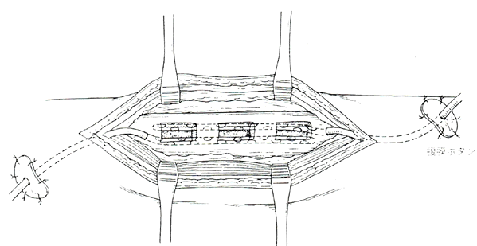
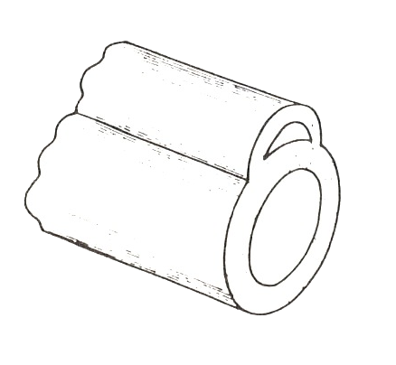
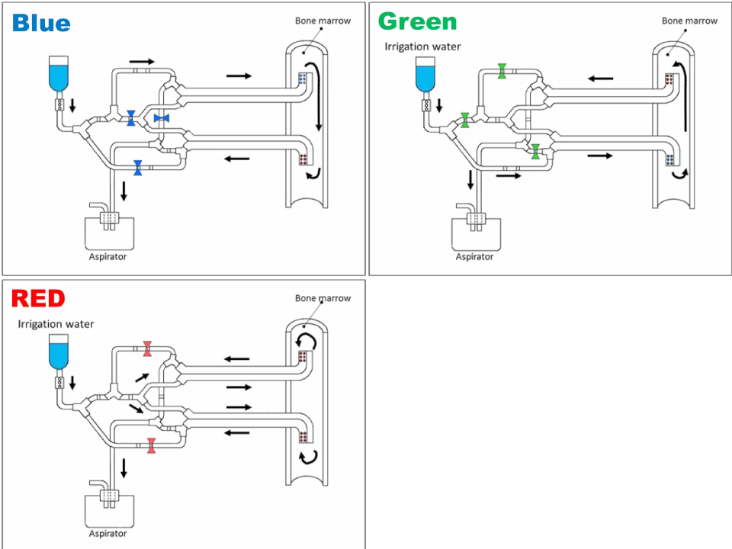
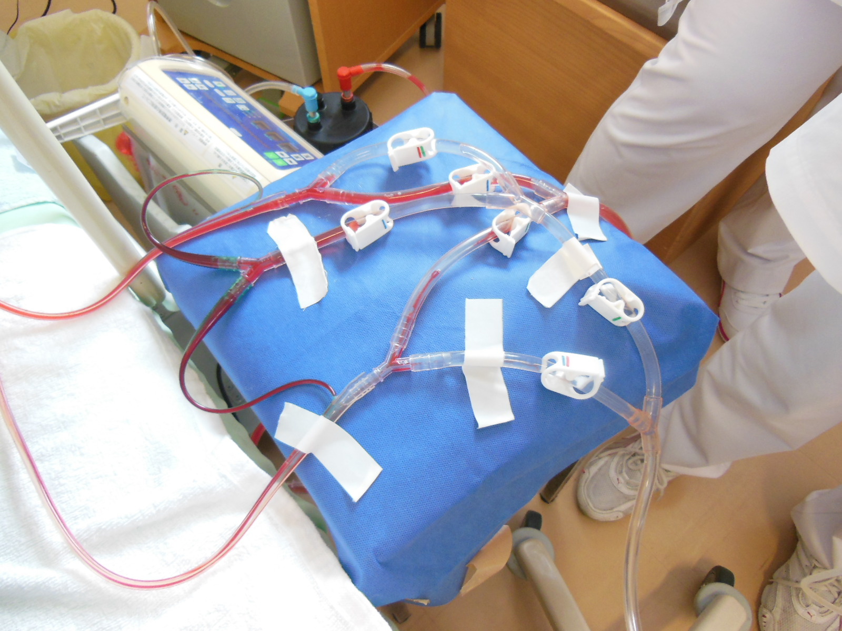
Procedure for closed irrigation
inlet
outlet
A cross-sectional view of a tube
Closed irrigation
Bone fenestration
Stabilization of the tubes
Double-pipe structure
Irrigation water
Overall view of closed irrigation therapy
1000～3000 ml/day
Play
Kawashima’s Closed Irrigation Therapy Circuit
Aspirator
-20-30mmH₂O
We can change the irrigation water flow by operating tube clamps.
Mahito Kawashima et.al.: Closed suction irrigation, Orthopaedic infection. Robert D (eds), 87-115, 1989

Slide 3
Infected site
Treated cases
Bacteria
Treatment result
January 2000 – September 2016
Kawashima Orthopaedic Hospital
Bacteria | cases
MRSA | 44
MSSA | 31
Corynebacterium sp | 22
Pseudomonas aeruginosa | 18
Staphylococcus epidermidis | 17
Enterococcus faecalis | 11
Peptostreptococcus sp | 8
α-Streptococcus | 7
Enterococcus sp | 7
Enterobacter cloacae | 7
E.coli | 7
Streptococcus agaractiae | 6
MRSE | 6
Serratia marcescens | 4
Klebsiella oxytoca
CNS
Citrobacter
Stenotrophomonas maltophilia | 3
Proteus vulgaris
MRCNS
Acinetobacter
β-Streptococcus | 2
Pasteurella multocida
Morganella morganii
Fusobacterium sp
Bacteroides
Alcaligenes sp
Acinetobacter lwoffi
Streptococcus pyogenes | 1
Streptococcus constellatus
Staphylococcus sp
Staphylococcus schleiferi
Staphylococcus haemolyticus
Staphylococcus auricularis
Pseudomonas stutzeri
Pseudomonas sp
Providencia rettgeri
Prevotella sp
Pantoea agglomerans
The number of case | 383 cases
Sex | Male：248 Female：135
101 cases
270 cases
(Serious cases)
12 cases were dropped out.
Results
Caused by | No. of cases
Trauma | 297 | 77.5%
Hematogeneus | 63 | 16.4%
Medicine | 1 | 0.3%
Unknoun | 22 | 5.7%
 | 383
371 cases
cases
 | Total | Good | Poor
HBOT | 270 72.8% | 249 92.2% | 21 7.8%
HBOT plus irrigation | 101 27.2% | 97 96.0% | 4 4.0%
Although significant difference was not seen in chi-square test, we think that irrigation plus group is more effective because the comparison of population is difference.
Tibia | 128 | 32.2%
Femur | 95 | 23.9%
Foot・Toe | 61 | 15.4%
Hand・Finger | 34 | 8.6%
jaw bone | 18 | 4.5%
Pelvis | 15 | 3.8%
Humerus | 10 | 2.5%
Clavicule | 9 | 2.3%
Fibula | 7 | 1.8%
Pattella | 6 | 1.5%
Radius | 4 | 1.0%
Ulna | 3 | 0.8%
Sternum | 2 | 0.5%
Vertebra | 2 | 0.5%
Sacrum | 2 | 0.5%
Scapula | 1 | 0.3%
 | 397
p=0.19, N.S. Chi-square test
Comparison of treatment result with HBOT vs. without HBOT
 | Good | Poor | Total
kawashima Orthopaedic Hospital 2000-2016 HBOT plus irrigation cases | 97 (96.0%) | 4 (4.0%) | 101
Kyushu Rosai Hospital 1970-1982 Treated with irrigation therapy without HBOT cases | 226 (88.3%) | 30 (11.7%) | 256
*Including multiple lesions
p>0.05 (Chi-square test)

Slide 4
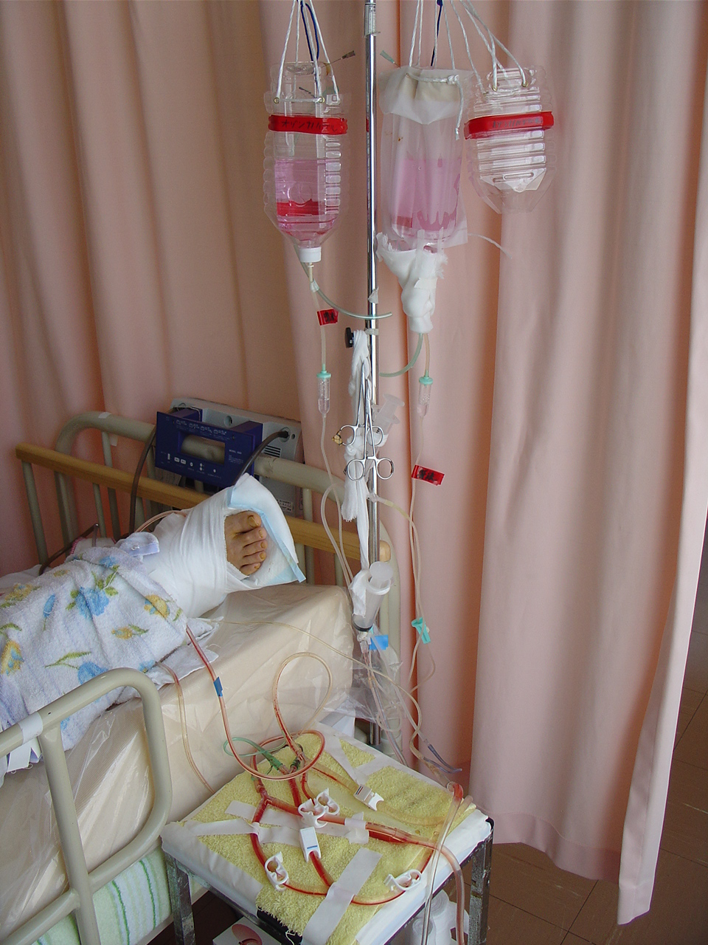
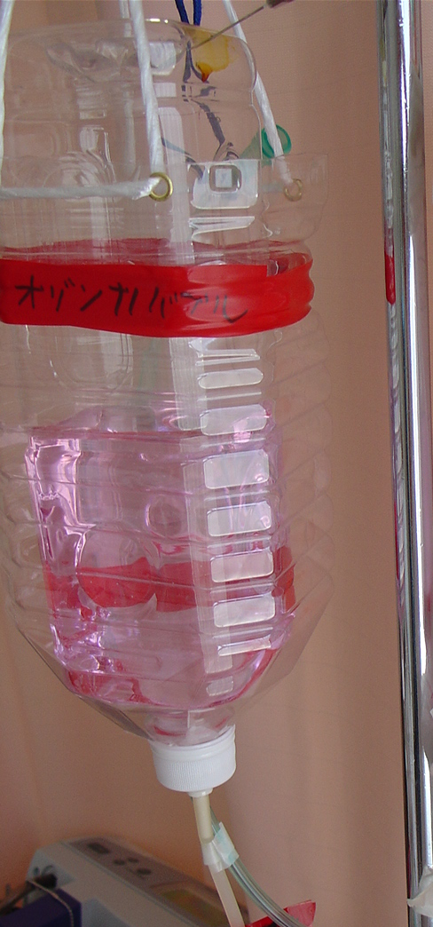
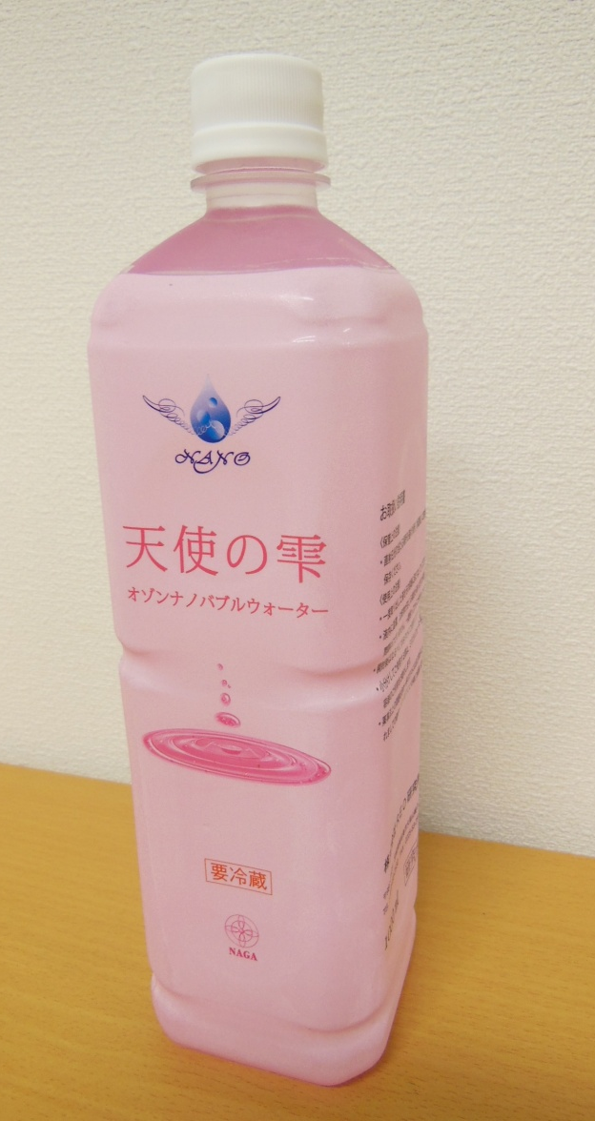
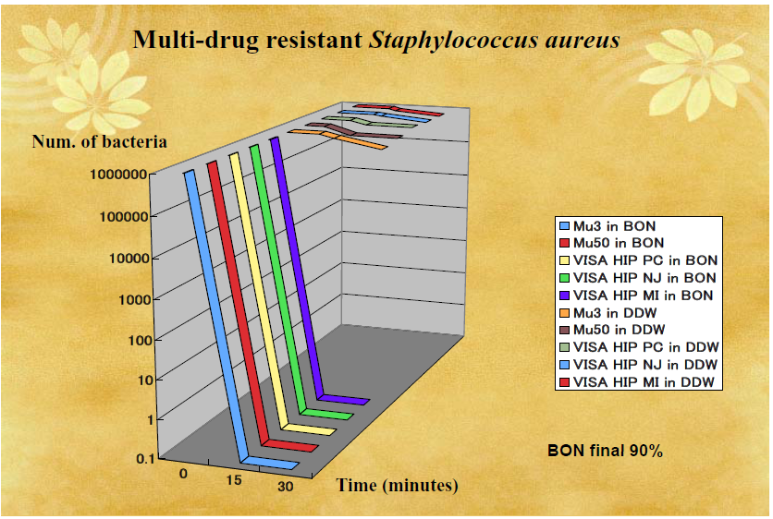
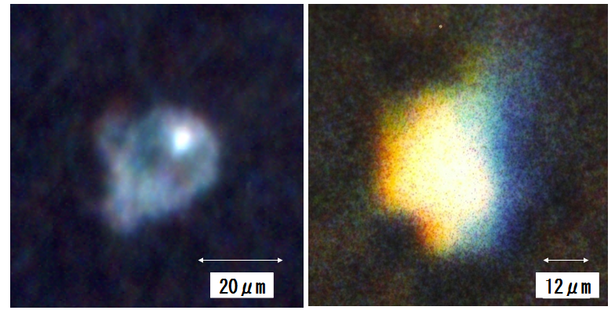
What’s “Ozone nano-bubble water” ?
Irrigation therapy with ozone nano-bubble water
nano-bubble
Nano bubble
Ozone
Bubbles where the diameter is less than 100 nano meter.
100 nm = 100 X 10⁻¹⁰m
Strong and wide spectrum sterilization
Harmless to tissue
Ozone dissolves in water stationary for a long term (more than 1 year)
A Japanese company succeeded in producing extremely tiny bubbles.
Treatment result of the irrigation therapy with “Ozone nano-bubble(NBW)”
Ozone nano-bubble
n=35
p=0.55
control
n.s. chi-square test
n=230
Masayuki Kawashima (2016)
The surface of nano-bubbles are charged to a minus voltage. When Nano-bubbles make contact with organic matter which are charged to a plus voltage, it generates stronger energy and free radicals.
Advantages of ozone nano-bubbles for osteomyelitis treatment
nano-bubble water
Shinichi Arakawa et.al. 2011
Ozone nano-bubbles
  are effective on multi-drug resistant bacteria.
  do not make bacteria resistant.
  do not damage the normal tissue.
  reduces tube blocking in closed irrigation therapy.
Hirofumi Ohnari: Maikuro baburu no subete, Nihon jitsugyo shuppan-sha 2006

Slide 5
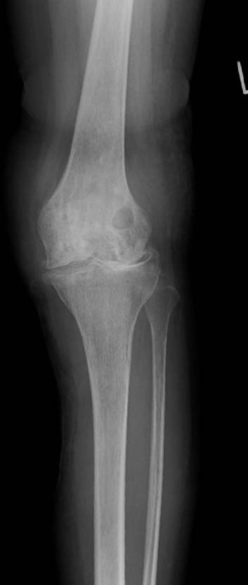
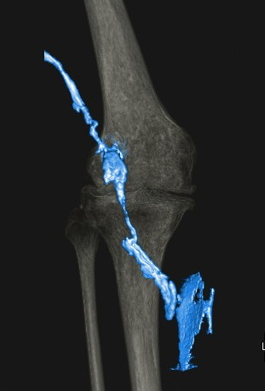
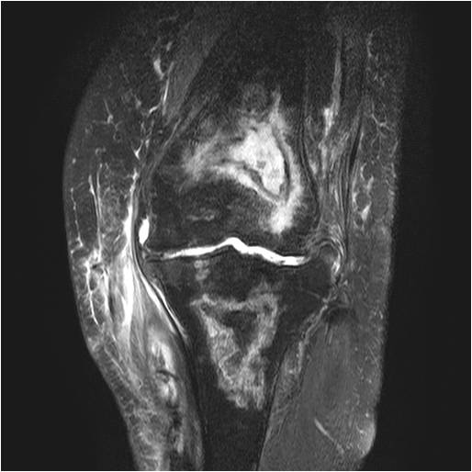
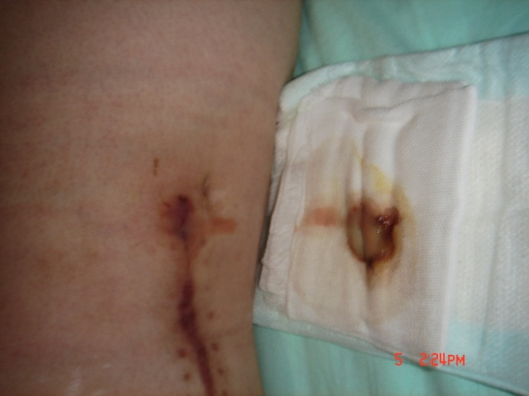
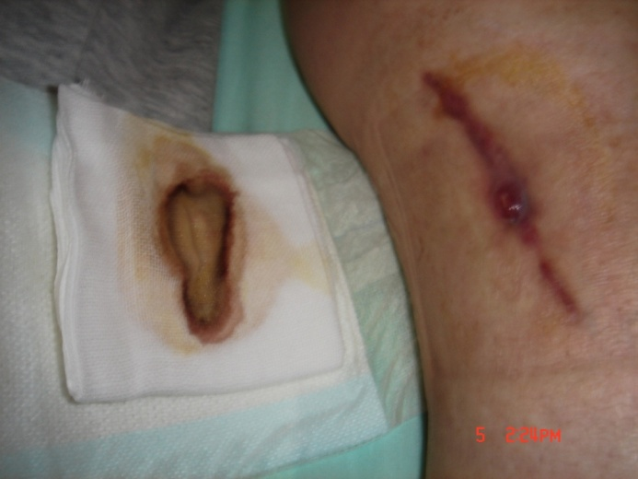
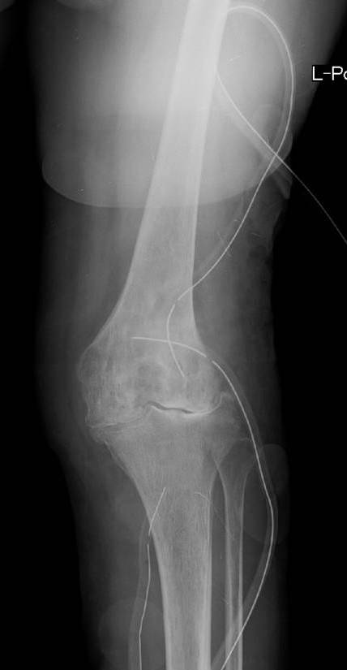
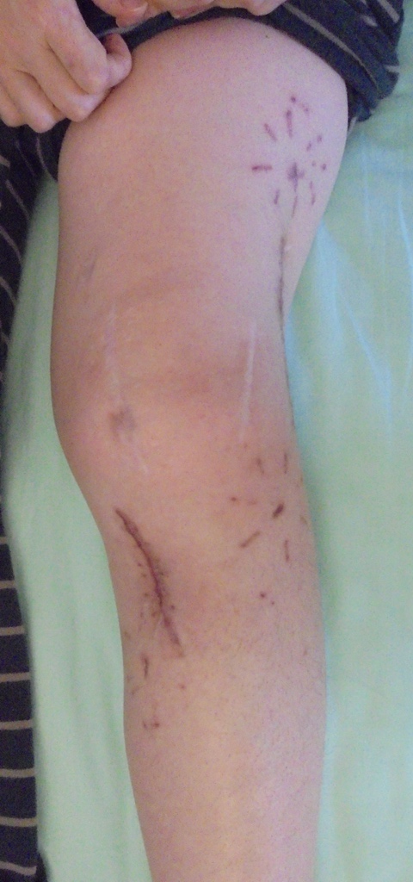
Case
40 yr. old female, Left femur osteomyelitis
Treated with HBOT plus Ozone nano-bubble irrigarion
Rationale
Jain KK. Hyperbaric oxygen therapy in infection. Textbook of Hyperbaric Medicine. In: Jain KK, eds. USA; Hogrefe & Huber 1990; 171- 91.
Mader JT, Brown GL, Guckian JC, Wells CH, Reinarz JA. A mechanism for the amelioration by hyperbaric oxygen of experimental staphylococcal osteomyelitis in rabbits. J Infect Dis 1980; 142: 915-922.
Jain KK. Hyperbaric oxygen therapy in infection. Textbook of Hyperbaric Medicine. In: Jain KK, eds. USA; Hogrefe & Huber 1990; 171- 91.
Calhoun JH, Cobos JA, Mader JT. Does hyperbaric oxygen have a place in the treatment of osteomyelitis? Orthop Clin North Am 1991; 22(3):467-71.
Gottlieb SF. Effect of hyperbaric oxygen on microorganisms. Ann Rev Microbiol 1971; 25, 111-152.
HBOT improves hypoxia of lesions.
Oxygen directly kills bacteria due to its toxic oxygen radicals.
Oxygen directly kills bacteria due to toxic oxygen radicals.
Oxygen enhances the leukocyte killing action.
High oxygen tension strengthens the effect of antibiotics.
a
b
c
a: x-ray
b:3D-CT of fistula angiography
c: MRI
d: pus discharge from fistula of distal thigh
e: pus discharge from fistula of proximal lower leg
Mader JT, Guckian JC, Glass DL, Reinarz JA.: Therapy with hyperbaric oxygen for experimental osteomyelitis due to Staphylococcus aureus in rabbits. J Infect Dis. 1978 Sep;138(3):312-8.
Niinikoski J, Hunt TK: Oxygen tensions in healing bone. Surg Gyn Obst, 134: 746, 1972
Horn DC. Host resistance of infection. Wound Infection. In: Hunt TK, ed. New York; Appleton- Century-Crofts 1980; 264-80.
Moor B, William RS: The growth of various species of bacteria and other microorganism in atmospheres enriched with oxygen. Biochem J, 5: 181-187, 1911
Ata. Saikin ni Oyobosu Koukiatsu oyobi taikiatu sanso kankyo no eikyou ni tsuite, The Japanese journal of hyperbaric and undersea Medicine, 1967; 2, 82-83.
Case/Conclusion
d
e
f
g
Conclusion
f: x-ray immediately after the closed irrigation.
g: 3 weeks after surgery (Closed irrigation was performed for 2 weeks, pus discharge subsided 1 week later.
HBOT is effective for osteomyelitis treatment due to its oxidative killing, enhancing the phagocytic activity of leukocytes and an antibiotic effectiveness due to the improvement of hypoxia.
In serious cases, good results are obtained if closed irrigation therapy is added.
Ozone nano-bubble water is the latest strategy for osteomyelitis treatment.
This patient received irrigation therapy many times in another hospital for 20 years.

